Slide 1
OPIM 5604
Predictive Modeling
Process of Predictive Modeling
Jennifer Eigo, Instructor in-Residence

Slide 2
Process of Predictive Modeling

Slide 3
Process of Predictive Modeling
Step 1 – Business Imperative & Sample
Step 2 – Explore the Data
Step 3 – Preprocess & Clean
Step 4 – Partition the Data
Step 5 – Model
Step 6 – Model Comparison
Step 7 – Model Selection
Step 8 – Implementation
Step 9 – Monitor & Update
Sample
Explore
Modify
Model
Assess

Slide 4
Step 1 – Business Imperative
Ascertain the business drivers
  Examples
    Retention problems
    Customer churn
Assess data availability
  Data sources
  Data procurement

Slide 5
Step 2 – Explore the data
Simple statistical analysis & visualization
  Stories that the data may tell
  Patterns of interest in the data
  Unearth data quality issues
  Document and communicate

Slide 6
Step 3 – Preprocess & Clean
Data types – numeric, ordinal, nominal
Fix errors
  For example, blank entries may mean ‘No’
Recode data
Missing values – drop or impute
Outliers – drop or transform
Reduce dimensionality – rows (sampling) or columns (principal components analysis)
Document data modifications

Slide 7
A Triage Approach to Preprocessing
Build a spreadsheet-like summary
  Variable name
  Number of unique values
  Most frequent value and corresponding frequecy
  % missing values
Look through data for the following
  Important variable names
  Variables with 1 level (completely useless)
  Variables that almost constant or almost all missing
  Duplicate variables with different names

Slide 8
A Triage Approach to Preprocessing
Split variables into three groups
  Known to be important
  Known to be unimportant
  Others, to be examined in more detail
Next, carefully examine the important variable to make sure they are what you think they are
Then, double check the unimportant variables
Finally, sort the “others” to decide if they will be useful or not
Expect data exploration and clean up to take 80% of the project time

Slide 9


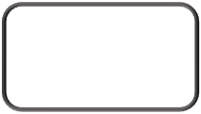
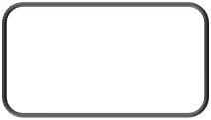
Step 4 – Partition the Data
Training
Data
Typical Splits:
  50/30/20
  40/30/30
  60/20/20
How data is split depends on:
  Complexity of predictive modeling & computational resources available
  Make training data set smaller if computational resources are limited
Original
Data
Validation
Data
Testing
Data

Slide 10
The Problem of Overfitting
Statistical models can produce highly complex explanations of relationships between variables
The “fit” may be excellent
When used with new data, models of great complexity do not do so well

Slide 11
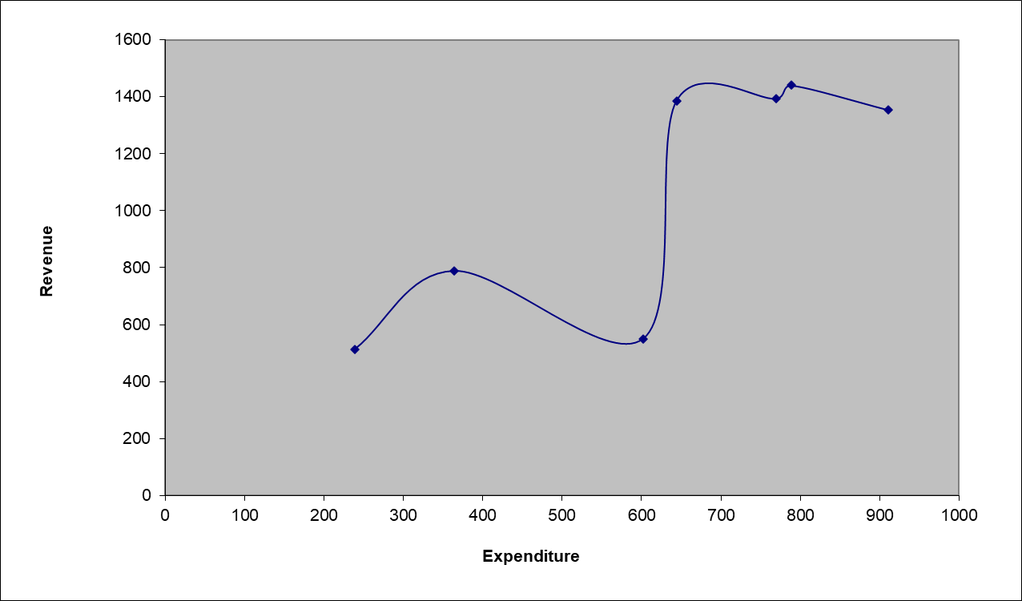
100% fit – not useful for new data

Slide 12
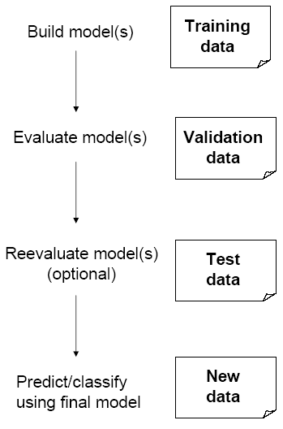
Partitioning the Data
Problem: How well will our model perform with new data?
Solution: Separate data into two parts
  Training partition to develop the model
  Validation partition to implement the model and evaluate its performance on “new” data
Addresses the issue of overfitting

Slide 13
Test Partition Justification
When a model is developed on training data, it can overfit the training data (hence need to assess on validation)
Assessing multiple models on same validation data can overfit validation data
Some methods use the validation data to choose a model. This too can lead to overfitting the validation data
Solution: final selected model is applied to a test partition to give unbiased estimate of its performance on new data

Slide 14
Sampling & Oversampling
Can be used to reduce the number of rows due to computational limits
Can also be used to balance data for model building when predicting a rare event - Oversampling
  Create balanced training samples.
  Keep validation and test sample proportional to the original data.
  Useful if your model is struggling to predict the majority class.
  This gives the model more info about the rare event in training to incentivize the model to identify it better.

Slide 15
Sampling Example - Continuous
A dataset has 1436 rows where each row represents a Toyota Corolla. Partition the dataset using a 50/30/20 split.
Solution:
Rows are randomly assigned to each partition according to the defined split.
Partition | Row Count
Training | 718
Validation | 431
Test | 287

Slide 16
Sampling Example - Classification
A dataset has 7,043 customers and it will be used for churn prediction. Of those customers, 1,869 have churned and 5,174 have not churned giving a 26.5% churn rate. Partition the dataset using a 60/20/20 split.
Solution:
Rows are randomly assigned to each partition so the original distribution of Churn is approximately the same in each partition.
Partition | Row Count | Churn | No Churn | % Churn
Training | 4,226 | 1,145 | 3,081 | 27%
Validation | 1,409 | 351 | 1,058 | 25%
Test | 1,408 | 373 | 1,035 | 26%

Slide 17
Oversampling Example
A dataset has 5,000 transactions and it will be used for fraud prediction. Of those transactions, 480 have been flagged as fraudulent and 4,520 are legitimate giving us a 9.6% fraud rate. Partition the dataset using a 40/30/30 split with a balanced training partition.
Solution:
Partition | Fraud | No Fraud | Row Count | % Fraud
Training | 480 x .4 = 192 | 192 | 192 + 192 = 384 | 50%
Validation | 480 x .3 = 144 | 4,520 x .3 = 1,356 | 144 + 1,356 = 1,500 | 9.6%
Test | 480 x .3 = 144 | 4,520 x .3 = 1,356 | 144 + 1,356 = 1,500 | 9.6%
Totals | 480 | 2,904 | 3,384

Slide 18


Step 5-1 – Predict with Model1
Predict using training data
Model1 could be decision tree
Write out the prediction formula for Model1
Training
Data
Model1
Results

Slide 19



Step 5-2 – Predict with Model2
Predict using training data
Model2 could be regression
Write out the prediction formula for Model2
Training
Data
Model1
Results
Model2
Results

Slide 20
Step 5-x – Additional Models
Predict using training data
Model3 could be neural network
Write out the prediction formula with Model3
Training
Data
Model1
Results
Model2
Results
Model3
Results

Slide 21



Step 6 – Model Comparison
Assess models on validation data
Check for overfitting
Fine tune parameters based on results
Training
Data
Model1
Results
Model2
Results
Model3
Results
Validation
Data
Model1
Results
Model2
Results
Model3
Results

Slide 22










Step 7 – Model Selection
Select the model that performs the best on test data
Document the final model prediction formula
Training
Data
Model1
Results
Model2
Results
Model3
Results
Validation
Data
Model1
Results
Model2
Results
Model3
Results
Test
Data
Model1
Results
Model2
Results
Model3
Results

Slide 23
Step 8 - Implementation
Implement the selected model
Issues to consider:
  Data needed to implement in production
  Software elements needed to run the model in real time
  Communication of model outcomes
  Compliance with rules and regulations
  Organizational structure to support process
  Complete documentation

Slide 24
Step 9 – Monitoring & Updates
Carefully monitor & communicate model performance
  Post monitoring to compare pre and post implementation
Implement triggers when performance deteriorates
  Be on the lookout for changes in the environment that would necessitate model tuning
Look for additional data that may become available that could enhance model capabilities

Slide 25
Summary
The process of predictive modeling helps us create reliable results
Partitioning the data protects against overfitting
Oversampling can help when we are predicting a rare event
Model performance can degrade over time so monitoring is important

